Slide 1

SARAN
SANTO ARUL RAJAA SACHIN SHANMUGA MANI
bring gender equality working place

Slide 2





BRAINSTORM

Slide 3
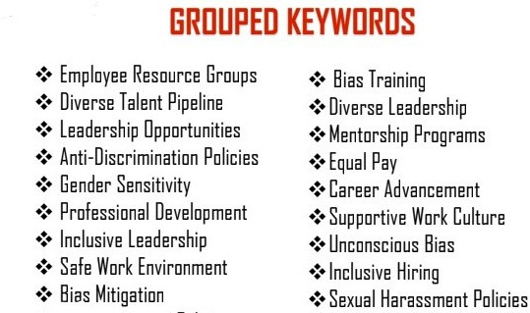

Slide 4























Diversity training
progessional development
Supportive work culture
Inclusive leadership
Gender sensitivity
Antidiscrimination
Policies
Inclusive Hring
Gender Neutral­
Polices
Bias mitigaiton
Bias awareness
MIND
MAPPING
'
I
cJ
Equal pay
Anti discrimination policies
Leadership work environment
Gender equality strategy
Talent development
Career advancement
Diversity Leadership
--

Slide 5


MATRIX TABLE

Slide 6

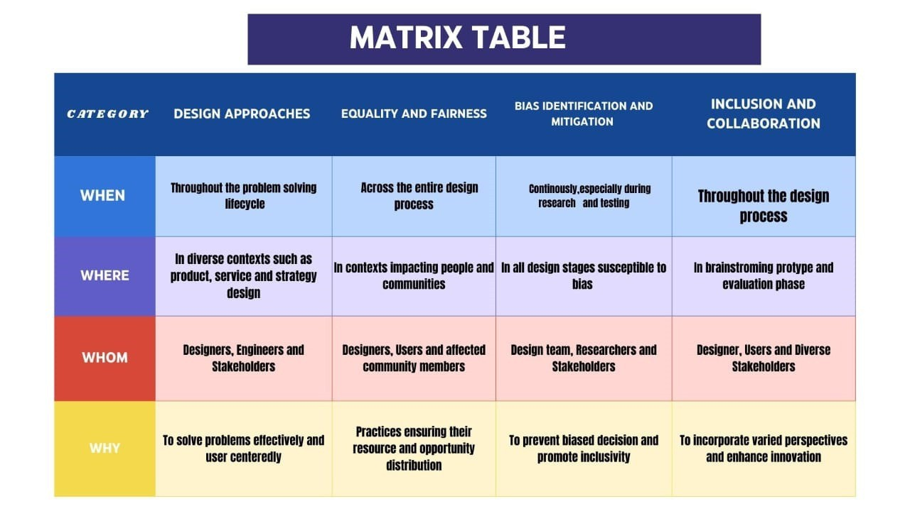



Slide 7
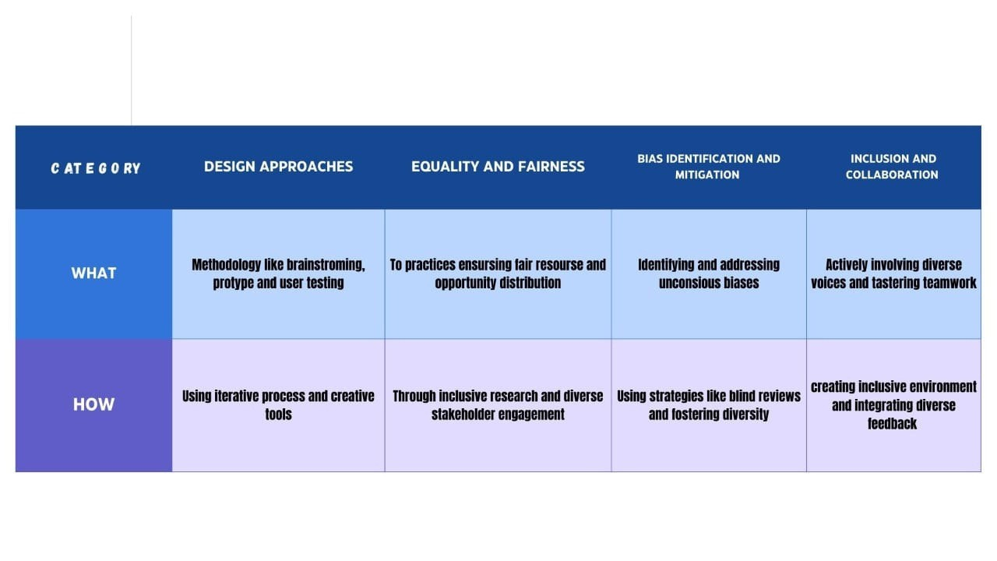


Slide 8

ACTIVITY
User Participants Mapping

Slide 9
Primary users:
Tertiary users:
External consultants
Industry regulator
professional Association
Academic researches
Advocacy groups
Employees
Human Resources
Team Leader
Executives
Diversity
Inclusion officers
Secondary users:
Work place traning
Internal policy maker
Employee Assitance
Mentors and coaching
union Representation
Quaternary users:
Media
policy makers
Educational institution
Community organization
Journalist

Slide 10


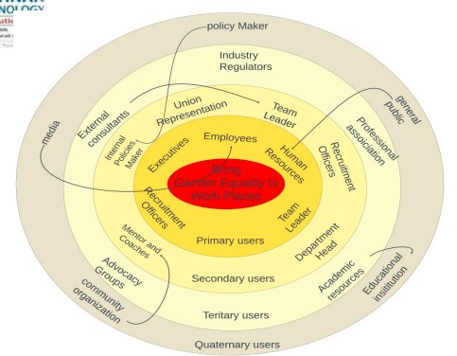






Slide 11
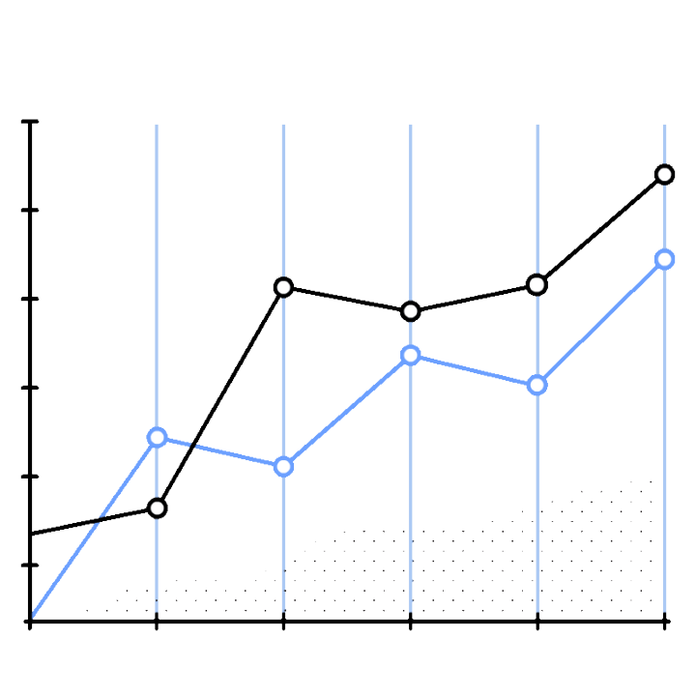


Slide 12
Inclusive Workplace 16.7%
Equal Pay 27.8%
Anti-Discrimination 27.8%
Leadership Opportunities 11.1%
Work-Life Balance 16.7%

Slide 13
men
women
100
80
60
40
20
0

Slide 14

A CONCEPTUAL MODEL FOR GENDER EQUALITY IN THE WORKPLACE
Structural Factors
Promotion and Leadership Opportunities Work-Life Balance Initiatives
Anti-Harassment & Discrimination Policies
Cultural Factors
Inclusive Workplace Culture Stereotype Reduction
Behavioral Factors
Training & Awareness Programs Employee Participation & Advoca
Measurement & Accountability Gender Equality Metrics Reporting Mechanisms Leadership Accountability

Slide 15
















QUESTIONNARIES
cue - cards

Slide 16






Question 1
How would you define gender equality?
Gender equality is when all
genders have the same
rights and opportunities.

Slide 17





Question 2
THINK
Why do you think gender equality is important in today’s society?
It ensures fairness and allows everyone to contribute equally to society.

Slide 18


Question 3
Which of the photos below shows a gender equal in Society?
A
B

Slide 19


ARTIFACT, ACTIVITY, MAPPING STEPS:
SPATIAL
BRING GENDER EQUALITY IN WORKING
PLACE

Slide 20


Identify Activities:
Define Artifacts:
IDENTIFY POLICIES AND TOOLS (E.G., EQUAL OPPORTUNITY POLICIES, DIVERSITY TRAINING MATERIALS) THAT DEMONSTRATE COMMITMENT TO GENDER EQUALITY.
OUTLINE INITIATIVES LIKE TRAINING WORKSHOPS, NETWORKING EVENTS, AND FEEDBACK MECHANISMS TO PROMOTE GENDER EQUALITY.

Slide 21



CONDUCT SPATIAL MAPPING:
VISUALIZE THE WORKPLACE LAYOUT TO ANALYZE GENDER DISTRIBUTION AND ASSESS RESOURCE ACCESSIBILITY.
MONITOR AND EVALUATE: REGULARLY ASSESS INITIATIVE EFFECTIVENESS, GATHER FEEDBACK, AND REPORT PROGRESS TO ENSURE ONGOING COMMITMENT.
ENGAGE STAKEHOLDERS: INVOLVE EMPLOYEES IN DISCUSSIONS AND WORKSHOPS TO GATHER INSIGHTS AND BRAINSTORM SOLUTIONS.

Slide 22


Slide 23
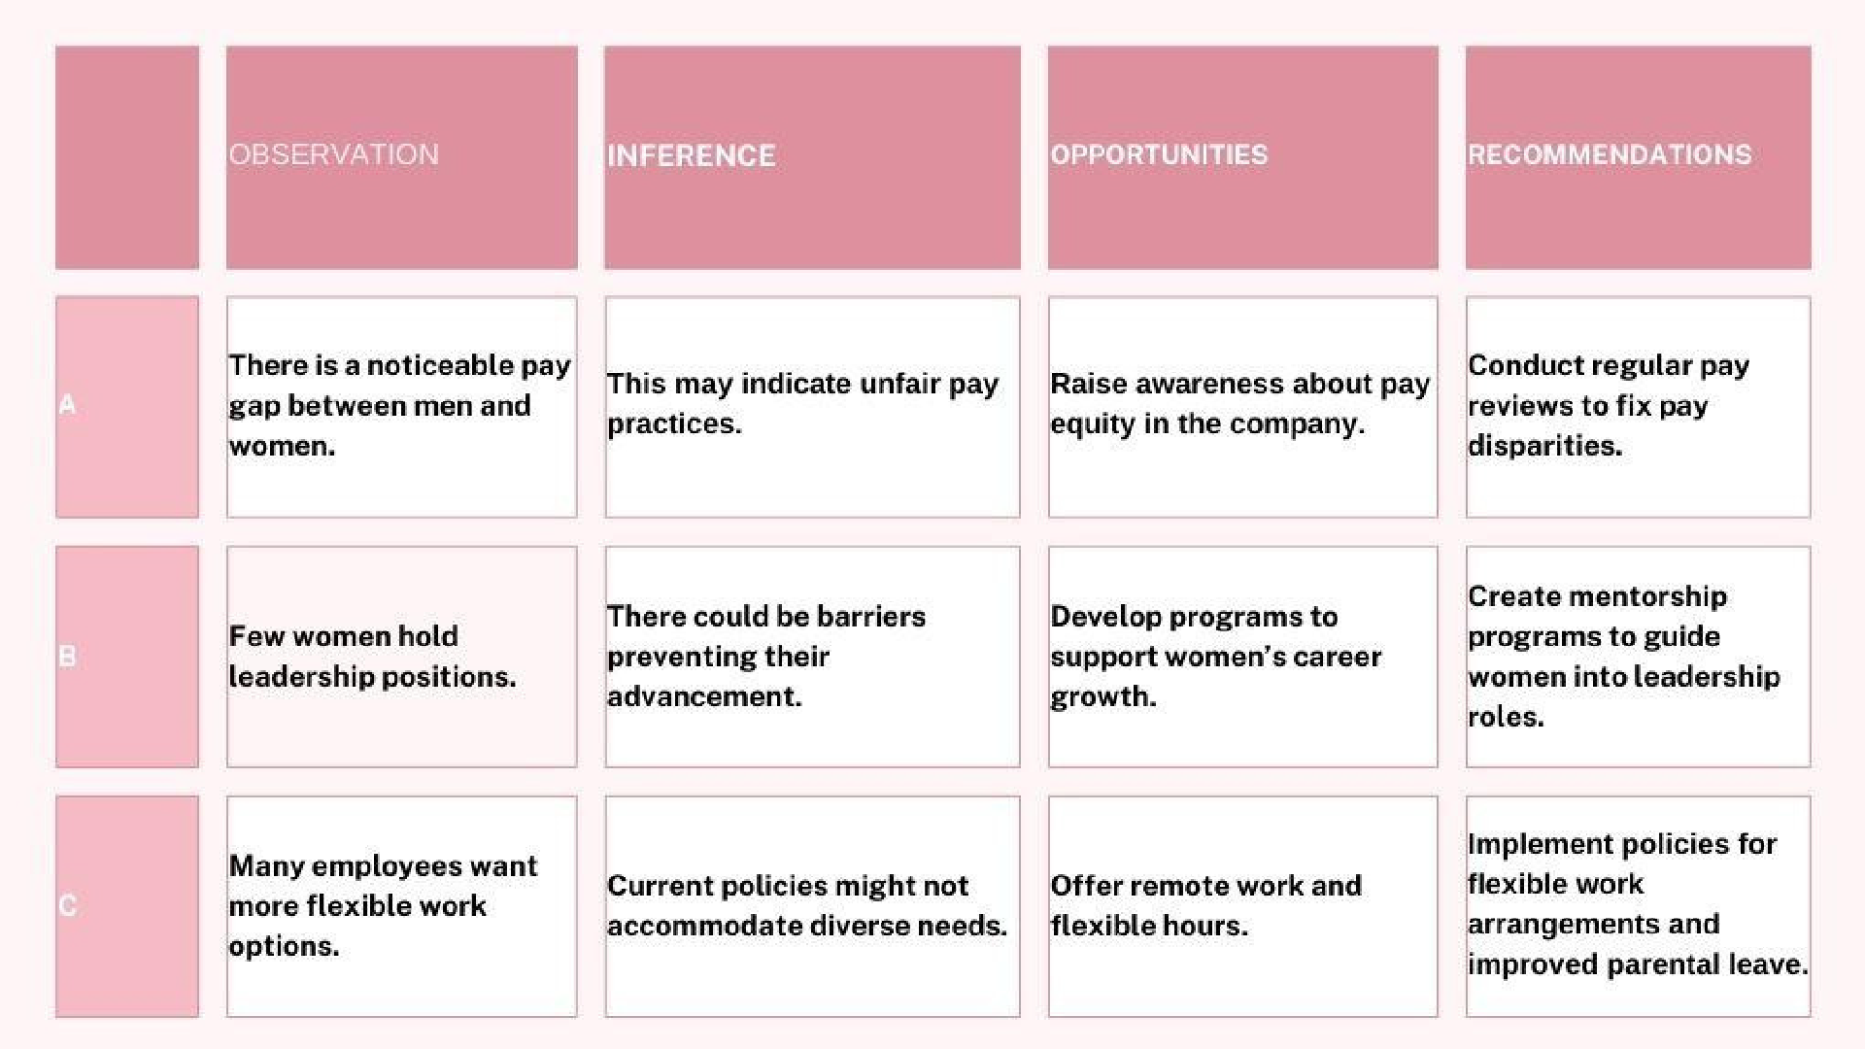

Slide 24

Thank You
For further inquiries and information
SARAN P
SANTO ARULRAJAA S
SACHIN B
SHANMUGA MANI M
REFERENCES: MRS. MURUGAVALLI

